Slide 1
INSERTs, UPDATEs, and DELETEs
DBMS-1002

Slide 2
In These Slides . . .
We will be covering:
INSERT: adding a new row to a table
DELETE: deleting a row from a table
UPDATE: replacing the value(s) of column(s) on a row.
COMMIT: A command to use after all of our changes.

Slide 3
Modifying Table Rows
In the course so far we have been able to:
SELECT rows from multiple tables
Create / Explain ERDs
Create our own tables
Following these sets of slides we will be able to modify the rows on existing tables.

Slide 4
Modifying Table Rows
We can modify rows in a table using these three 3 keywords:
INSERT: add a new row to a table
DELETE: deletes row(s) from a table
UPDATE: changes the value(s) of column(s) on a row in a table
NOTE:
These commands are done one table at a time, so if you need to modify two tables, it will take two separate commands…

Slide 5
INSERT - Adding data to a database
We use the INSERT command to add new rows to a table.
Syntax:
Columns are a list of comma separated column names.
Values are a list of comma separated values that MUST match the number and order of the columns.
INSERT INTO table_name (column1,column2…)
VALUES (value1,value2…);

Slide 6
INSERT - Columns
Columns:
Each column name must exist in the table
Can be in any order … however you should use the order from the CREATE TABLE
If a column is not specified during the INSERT:
The column value will be NULL or DEFAULT (if specified)
Columns with a NOT NULL constraint *MUST* be included or will result in an ERROR

Slide 7
INSERT - Values
Values:
Must match the number of columns specified
Ex: 3 columns = 3 values
The order of the columns will match 1 to 1 with the values:
column1 = value1,
column2 = value2, etc…
Must match the column datatype
Ex: If column1 is a VARCHAR(50), the value must be less than 50 characters.

Slide 8
INSERT - Values
INSERT INTO table_name (column1, column2…)
VALUES (value1, value2…);
Values are checked against all table CONSTRAINTS before the row is actually inserted:
PRIMARY KEY
FOREIGN KEY
CHECK
UNIQUE
NOT NULL

Slide 9
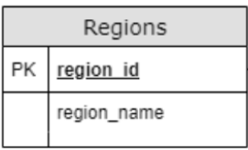
INSERT - Example
Example:
Adding a new Region named Oceanic.
Note: The number of values match the number of columns and the data types match as well…
region_id is a NUMERIC
region_name is a VARCHAR(25)
INSERT INTO Regions (region_id, region_name)
VALUES (6,'Oceanic');

Slide 10
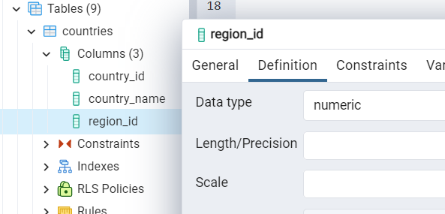
Table and Column details the IDE
We can use our IDE ( PgAdmin) to discover table and column details.
Expand Tables in the left pane to display the tables available
Then expand the specific table and then expand the columns
Right click any column name, choose properties, choose the definition tab

Slide 11
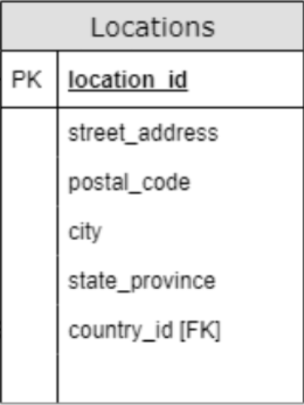
INSERT - Example
Example: Now let’s add a new location and provide a value for each column...
INSERT INTO Locations (location_id,
street_address,
postal_code,
city,
state_province,
country_id)
VALUES (3400,
'555 Smith St',
'R2J 3R4',
'Winterpeg',
'Manitoba',
'CA');

Slide 12
INSERT - Missing columns
Here is another location with missing columns:
Two columns are missing: street_address and postal_code
The default values for these columns will be set to: NULL
Note: An error would occur and prevented the INSERT had either of the two columns had a NOT NULL constraint
INSERT INTO Locations ( location_id,
city,
state_province,
country_id )
VALUES (3500,'Calgary','Alberta','CA');

Slide 13
DELETE - Removing data from a database
We use the DELETE command to remove rows from a table.
Syntax:
For each row if the conditions result in TRUE, the row will be removed.
IMPORTANT NOTE: If the WHERE clause is omitted, you delete ALL ROWS in the table!
DELETE FROM table_name
WHERE (conditions);

Slide 14
DELETE - Removing data from a database
Example: Delete the Employee named: 'John Smith'
What concerns would you have executing this SQL?
How many John Smith’s are there?
How do we know we’re deleting the right John Smith?
We should use the PRIMARY KEY instead!
DELETE FROM Employees
WHERE first_name = 'John'
AND last_name = 'Smith';

Slide 15
DELETE - Example with PK
Example: Remove the location created in the previous example with the location_id of 3400
You should always delete rows based on the PRIMARY KEY column when possible.
Why?
The PK column is unique and this will avoid accidentally deleting more rows than expected!
DELETE FROM Locations
WHERE location_id = 3400;

Slide 16
DELETE - Example IS NULL
Example: Remove all locations with a missing postal_code.
Question: Why do we use IS instead of = ?
Answer: = assumes a value. NULL is nothing. It is not a value.
Sometimes we may want to delete multiple rows at the same time on purpose.
Ultimately, we can use any of our usual boolean expressions in the WHERE clause that we used in our SELECTs.
DELETE FROM Locations
WHERE postal_code IS NULL;

Slide 17
UPDATE - Modifying data within a database
We use the UPDATE command to update rows from a table.
Syntax:
For each row, if the conditions result in TRUE, the row will be updated.
The new values supplied will replace the old column values.
IMPORTANT: Omitting the WHERE clause conditions will update ALL ROWS.
UPDATE table_name
SET column_name = 'new value',
column_name2 = 'new value2'
WHERE (conditions);

Slide 18
UPDATE - Modifying data within a database
Before the UPDATE command executes...
All table constraints are checked:
PRIMARY KEY / FOREIGN KEY,
CHECK,
UNIQUE,
NOT NULL
The new values supplied must match the column datatype

Slide 19
UPDATE - Modifying data within a database
Example: Modify employee_id 100. Increase their salary to 25000. Also change their last name to 'Kingster' and their email to 'SKINGSTER'.
Note: Using the PRIMARY KEY column in the WHERE clause is useful to only update a specific record at a time.
UPDATE Employees
SET salary = 25000,
last_name = 'Kingster',
email = 'SKINGSTER'
WHERE employee_id = 100;

Slide 20
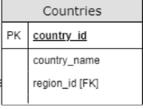
UPDATE - Modifying data within a database
Example: Modify the country of Australia (country_id is 'AU'). Remove the region_id as it is no longer considered part of region_id 3.
Note: We do not use IS NULL here, because we are assigning the value of NULL and not comparing it in a boolean expression.
Notice how the SET clause uses ‘=‘
Whereas the WHERE clause would use ‘IS NULL’
UPDATE Countries
SET region_id = NULL
WHERE country_id = 'AU';

Slide 21
UPDATE - Modifying data within a database
Example: Increase the max salary by 100 for the following jobs: IT_PROG, SA_REP,MK_MAN
Note: Three records will be updated here with a single statement
UPDATE Jobs
SET max_salary = max_salary + 100
WHERE job_id IN ('IT_PROG',
'SA_REP',
'MK_MAN');

Slide 22
COMMIT
After making changes to the database you will want to use the COMMIT command at the end of your SQL file to save your changes to the server.
COMMIT;

Slide 23
Summary
We covered:
INSERT: adding a new row to a table
DELETE: deleting a row from a table
UPDATE: replacing the value(s) of column(s) on a row
COMMIT: command to use after all of our changes

